Slide 1
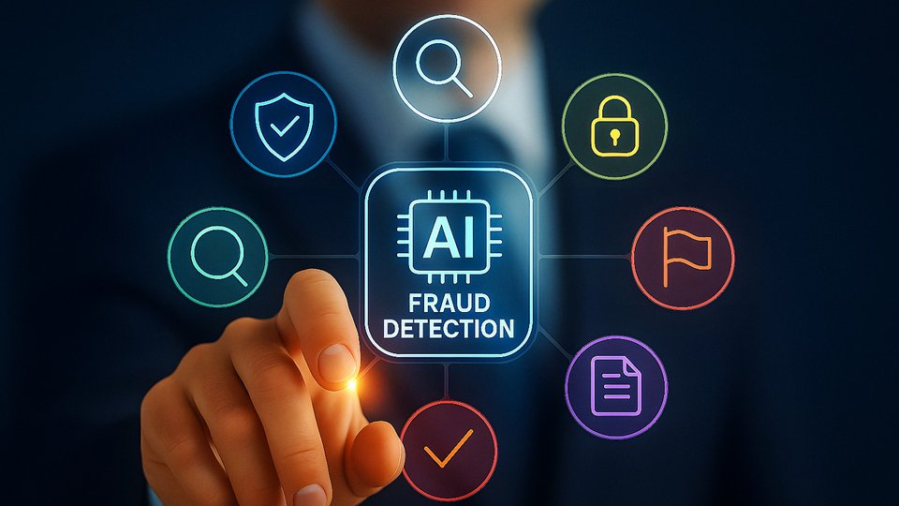
AI-Driven Phishing Detection and Prevention in Online Retail Pharmaceutical Businesses

Slide 2
Executive Summary
High-Value Data
Multi-Vector Attack Surface
Online retail pharmacies process prescription, payment, identity, and health data—creating lucrative targets
Phishing exploits customers and employees through email, SMS, voice, portals, and vendor channels
AI Detection Opportunity
Bounded AI Governance
Generative AI improves semantic phishing detection, multilingual analysis, and analyst explanation
Agentic AI should support triage and workflow orchestration—not fully autonomous security decisions
Source: HHS, 2026; Verizon, 2025; FBI, 2024; NIST, 2025

Slide 3
Research Objectives
01
02
03
Examine Sector Specific Phishing Risks
Analyze Generative AI Detection
Evaluate Agentic AI Capabilities
Evaluate semantic analysis and deceptive message identification
Assess triage, evidence gathering and incident response automation
Identify vulnerabilities unique to online retail pharmaceutical operations
04
05
Identify Implementation Limits
Propose Auditable Framework
False positives, privacy risks, adversarial attacks, compliance issues
Practical, compliant AI driven cybersecurity implementation
Source: Research synthesis based on HHS, NIST, OWASP, Verizon, IBM, and FBI guidance

Slide 4

Why Online Retail Pharmacy Is Uniquely Exposed
Healthcare Data
Prescriptions, diagnosis-related history, patient identifiers
Retail Data
Payments, order history, shipping addresses
Trusted Communications
Refill reminders, delivery alerts, insurance updates
Vendor Dependency
PBMs, couriers, payment processors, email providers, telehealth partners
High-Value Phishing Target
Source: HHS, 2026; Mohammed et al., 2024

Slide 5







Sensitive Data Map
What attackers target in online retail pharmacy systems
Prescription Data
Account Credentials
Payment Credentials
Medication lists, dosages, refill history, controlled substances
Username, password, session tokens, authentication methods
Card numbers, CVV, billing addresses, payment method preferences
Insurance Details
Address Information
Support Transcripts
Policy numbers, coverage information, claims history
Shipping addresses, delivery preferences, contact details
Customer service interactions, complaint history, resolution details
Health History
Diagnosis codes, treatment plans, refill patterns, medical conditions
PHI + PII + Payment Data = Maximum regulatory exposure and black market value
Source: HHS, 2026; IBM, 2024

Slide 6
Threat Landscape Snapshot
22%
15%
Credential Abuse
Phishing Driven
Breach initial access vector
Percentage of breaches
30%
60%
Third Party Involvement
Human Element
Supply chain compromise
Personnel involvement
Source: Verizon, 2025

Slide 7

Why Healthcare Breaches Are More Expensive
$4.88M
Global Average
Average breach cost across all industries
$10.93M
Healthcare Average
Average breach cost in healthcare sector
AI and automation reduce breach lifecycle and cost when properly implemented
Source: IBM, 2024

Slide 8


Cautionary Case: Change Healthcare
1
Credential Compromise
Stolen credentials enable initial access
2
Portal Access
Single trusted portal exploited
3
Service Disruption
System wide compromise
4
Notification Burden
Operational, legal and notification consequences
Key Lessons: Stolen credentials create system wide compromise. Lack of phishing resistant MFA increases exposure. Healthcare cyber incidents create operational, legal and notification burdens. One trusted portal can become a national scale breach vector
Source: HHS OCR, 2025; Reuters reporting

Slide 9
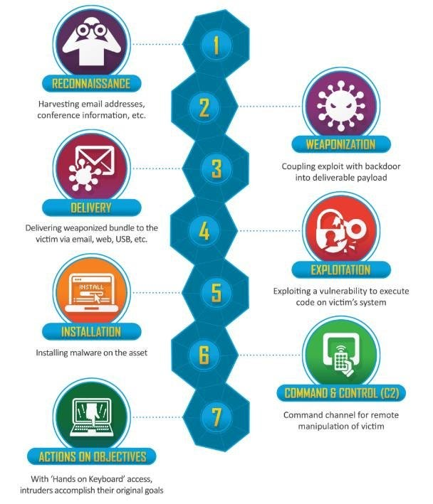





Pharmacy Phishing Kill Chain
Five-stage attack path from lure to exploitation
Lure Creation
Deceptive message crafted
Message Delivery
Email, SMS, or voice sent
User Response
Click or credential entry
Compromise
Credential or session theft
Exploitation
Fraud, data theft, lateral movement
Source: FI, 2024; Verizon, 2025

Slide 10



Customer Targeted Phishing Lures
Common deceptive messages in online pharmacy operations
"Your refill is delayed."
"Payment failed for your prescription."
"Verify insurance to continue order."
"Controlled medication confirmation required."
"Delivery address issue."
"Upload prescription again."
Illustrative examples based on observed phishing patterns. Not actual messages.
Source: FBI, 2024; HHS, 2026

Slide 11


Employee Targeted Phishing Lures
Internal attack surfaces expanding across operational and corporate functions
Operational Staff Risks
Corporate/Finance Risks
Supplier invoice scams
IT password reset requests
Courier/vendor escalations
PBM portal updates
HR document fraud
Executive payment requests
Compliance audit notices
Source: FBI Internet Crime Report, 2024; Verizon Data Breach Investigations Report, 2025

Slide 12





How Generative AI Changes Attacker Economics
AI enables criminals to produce polished, personalized attacks at scale which makes traditional filters ineffective
Polished Messages
Personalized Lures
Multi Language Attacks
No grammar errors, professional tone
Using public or breached data
Translated across regions instantly
Realistic Scripts
Filter Evasion
Support scripts generated rapidly
Rapid variations to bypass filters
"Criminals use generative artificial intelligence to facilitate financial fraud" - FBI, 2024

Slide 13













Multichannel Phishing: The New Default
Attackers no longer rely on email alone: threats span every communication channel
Email
SMS
Spoofed Portals
Voice Calls
Web Chat
QR Codes
Source: FBI Internet Crime Report, 2024; OWASP Top 10, 2025

Slide 14

Deep-fake and Voice Cloning Risk
Call Center Threat Scenarios
AI generated voices enable sophisticated social engineering against helpdesk and customer support
Fake Executive Approval Calls
Fake Pharmacy Support
Voice Cloned Patients
Urgent payment authorization requests
Medication or refill fraud
Impersonation of caregivers
Callback Fraud
Helpdesk Social Engineering
Exploiting trust after initial contact
Tricking agents into account access
Source: FBI Internet Crime Report, 2024

Slide 15



Business Email Compromise and Payment Diversion
Financial fraud through compromised accounts and manipulated invoices
Compromised Supplier Email
Fake Invoice
Payment Redirection
Account takeover or credential theft
Altered payment details sent
Funds sent to attacker accounts
Additional Business Email Compromise Pathways
Pharmacy procurement fraud
Payroll manipulation
Refund fraud schemes
Source: FBI Internet Crime Report, 2024

Slide 16














Third Party Amplification
Supply chain partners expand phishing exposure across the entire ecosystem
Payment Processors
Email Platforms
Pharmacy Benetit Managers
Marketing Tools
Courier Networks
Support Vendors
Telehealth Partners
Source: Verizon Data Breach Investigations Report, 2025; HHS Cyber Gateway, 2026

Slide 17
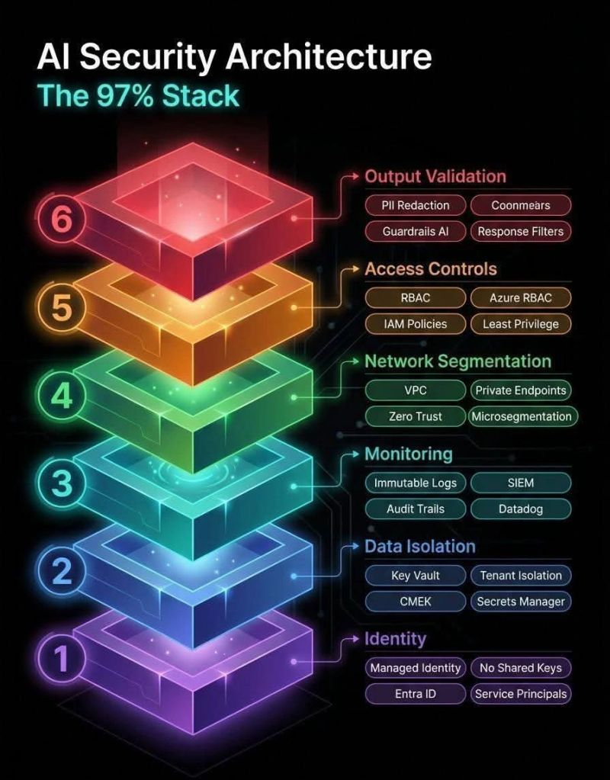







Defensive AI Stack
Layered protection model combining traditional controls with modern AI and human oversight
Deterministic Controls
Spam filters, blocklists, DMARC
Rule-Based Filters
Keyword and sender checks
Classic ML Classifiers
Statistical pattern detection
Transformer/LLM Analysis
Semantic understanding
Agentic Orchestration
Automated threat response
Human Governance
Audit and decision oversight
Source: NIST AI Risk Management Framework, 2023; NIST Cybersecurity Framework, 2024; OWASP Top 10, 2025

Slide 18

Why Transformers Matter
Traditional ML detects patterns but transformers detect context, intent, and deception
Rules-Based Detection
Keyword and sender checks only
Classic ML Classifiers
Statistical features and patterns
Transformer/LLM Analysis
Semantic intent, tone, impersonation, context mismatch
Source: Comparative phishing email detection study, 2024

Slide 19







Generative AI for Semantic(word based) Phishing Analysis
AI evaluates linguistic patterns to identify manipulation and deception
Urgency Detection
Impersonation Intent
Brand Mismatch
Suspicious Requests
Language Patterns
Context Inconsistency
Source: Bellamkonda, 2022; comparative phishing email detection study, 2024

Slide 20
URL, Domains and Behavioral Analytics
Technical detection combined with behavioral signals to identify account takeover
URL and Domain Analysis
Behavioral Analytics
Lookalike Domains
Impossible Travel
Character substitution and homoglyphs
Geographically impossible logins
URL Redirection
New Device Login
Multi-hop obfuscation chains
Unfamiliar hardware detection
TLS/Certificate Mismatch
Repeated Password Resets
Invalid or self-signed certificates
Brute force credential testing
Brand Impersonation
Unusual Checkout Behavior
Fake landing pages and portals
Abnormal transaction patterns
Newly Registered Domains
Prescription Access
Recently created suspicious domains
Abnormal medication requests
QR Code Risk
Address Changes
Hidden malicious destinations
High risk shipping modifications
Failed MFA Attempts
Multifactor authentication bypass
Source: PhishTransformer study, 2024; Verizon Data Breach Investigations Report, 2025; NIST Cybersecurity Framework, 2024

Slide 21
Customer Facing AI Controls
01
02
03
Login Security
Refill Verification
Payment Protection
Risk scoring, step up authentication
Safe refill checks, warnings
Confirmation safeguards, fraud detection
04
05
Delivery Monitoring
Support Channels
Tracking alerts, verification
Portal warnings, escalation paths
Source: CISA, 2023; HHS, 2026

Slide 22

Employee Facing AI Controls
Internal workforce protection mechanisms
Key Controls
Report-phish button with AI triage
Intelligent mailbox banners
AI-generated analyst summaries
High-risk sender warnings
Invoice anomaly detection
Helpdesk social-engineering alerts
Source: Microsoft, 2025; Microsoft, 2026

Slide 23
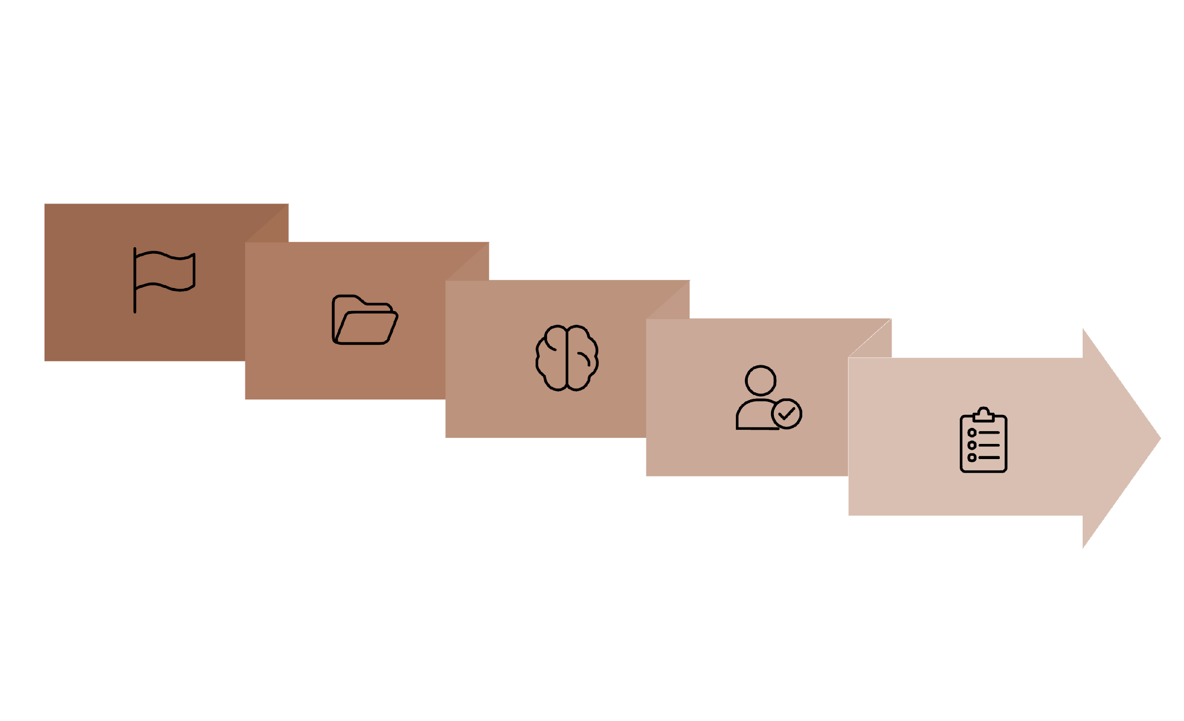





Agentic AI Triage Workflow
Automated evidence collection and human review
Report
Analyze
Log
Collect
Review

Slide 24

Agentic Response Actions
Separating automation from human approval requirements
✓ Automated Actions
⚠ Approval Required
Cluster duplicate reports
Enrich with threat intelligence
Draft analyst summary
Recommend quarantine
Open ticket
Notify SOC queue
Disable account
Freeze transaction
Notify customer
Escalate privacy incident
Block supplier domain globally

Slide 25






Reference Architecture
End to end security infrastructure components
Data Ingestion
Preprocessing
Email, SMS, chat, login, checkout, support
PHI minimization, masking, tokenization
Detection Layer
Policy Engine
Rules, ML, transformer/LLM models
Risk thresholds, compliance rules
Agentic Orchestration
Approval Gates
Evidence collection, triade(CIA)
Human review checkpoints

Slide 26
Risk and Governance
False Positives
Operational risks of over detection
Alert Fatigue
Delayed Prescriptions
Customer Frustration
SOC teams overwhelmed by volume
Legitimate orders unnecessarily blocked
Lost trust, unnecessary step ups
False Negatives and Evasion
Why attackers still penetrate defenses
Paraphrased Lures
Multilingual Phrasing
Compromised Accounts
Benign-looking sender chains
Timing attacks near delivery events
QR code redirection, attachment pivots
Source: NIST, 2023; IBM, 2024; NIST, 2025; OWASP, 2025

Slide 27
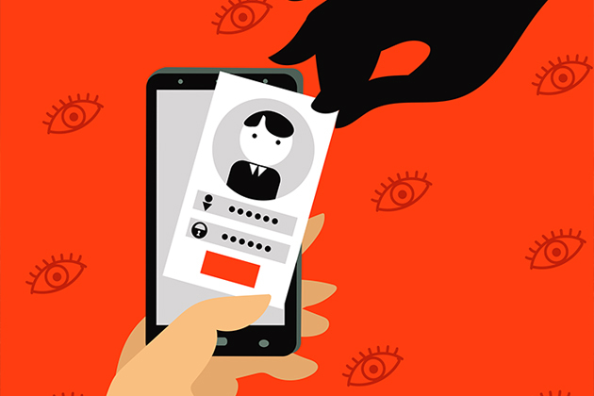




Privacy Risks in Regulated Environments
PHI exposure in AI workflows
PHI Leakage
Sensitive health information entering model prompts during processing
Over-Retention
Extended storage of support transcripts without proper minimization
Vendor Processing Risk
Third-party model providers accessing protected health information
ReIdentification Risk
Payment linked health inference from transaction patterns
Source: HHS, 2026; NIST, 2023

Slide 28
Compliance Map
Regulatory frameworks and security controls
Framework
Security Control
HIPAA Security Rule
MFA, Encryption, Logging, Incident Response
HHS Cybersecurity Goals
Email Security, Third-Party Risk
PCI DSS
MFA, Encryption, Logging
NIST CSF 2.0
AI Governance, Human Review, Logging
NIST AI RMF 1.0
AI Governance, Explainability, Human Review
OWASP LLM Top 10
AI Governance, Human Review
Source: HHS, 2026; NIST, 2023; NIST, 2024; OWASP, 2025; PCI SSC guidance

Slide 29
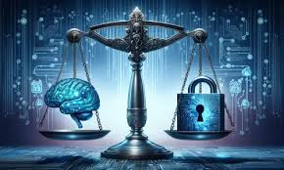
Explainability and Auditability
Mandatory transparency for AI-supported decisions
Required Elements
Risk score with evidence summary
Model rationale and rule triggers
Human reviewer identification
Action taken and timestamp
Override option with justification
Retention policy enforcement
100%
24/7
Decision Traceability
Review Access
Full audit trail required
Continuous oversight capability

Slide 30







Continuous Validation and Red Teaming
Make governance operational through an ongoing validation loop that ensures AI security systems remain effective against evolving threats.
Simulate Campaigns
Benchmark
1
2
Test with realistic phishing scenarios
Establish baseline performance metrics
Red Team Models
7
3
Attack your own AI systems
Reaudit Controls
Verify compliance and effectiveness
Measure Errors
6
4
Track false positives and negatives
Retrain Systems
5
Adjust Thresholds
Update models with new data
Tune detection sensitivity

Slide 31












Proposed Practical Framework
A six phase approach to implementing AI-powered phishing defense in pharmacy environments.
Scope Attack Surface
Build Privacy Pipeline
Map pharmacy specific vulnerabilities
Minimize PHI exposure in data flows
Continuous Improvement
Deploy Detection
Refine through metrics and testing
Layer multiple security controls
Govern Controls
Bounded Triage
Enforce compliance and audit trails
Use agentic AI within safe limits

Slide 32
Phase 1: Readiness Assessment
Assessment Areas
Data inventory and classification
Current phishing volume trends
Historical incident patterns
Email security maturity level
MFA coverage across systems
Vendor dependency mapping
SOC staffing and capabilities
Customer-service workflows
Source: NIST, 2024; HHS Cyber Gateway, 2026

Slide 33





Phase 2: Secure Data Pipeline
Implement privacy-first AI by minimizing PHI exposure throughout the entire data processing workflow.
Ingestion
Collect only necessary signals
Minimization
Mask PHI and tokenize identifiers
AI Analysis
Separate prompts from raw records
Policy Engine
Restrict permissions and log access
Audit
Enforce retention limits
Source: HHS, 2026; AWS, 2025; NIST, 2023

Slide 34
Phase 3: Pilot Use Cases
Start with practical, high-impact scenarios that demonstrate immediate value while building organizational expertise.
Inbound Email Triage
Account Takeover Prevention
Helpdesk Protection
Automatically analyze and prioritize phishing emails using semantic AI detection
Detect suspicious login patterns and credential abuse in customer accounts
Identify social-engineering attempts targeting customer service representatives
Invoice Verification
Transaction Warnings
Flag supplier impersonation and fraudulent payment requests
Alert on suspicious refill or payment messages requiring human review
Source: Microsoft, 2026; Verizon, 2025; FBI, 2024

Slide 35




Phase 4: Bounded Automation
Define clear autonomy boundaries to ensure AI systems enhance security without introducing unacceptable risk.
Green Tier: Safe Actions
Summarize threats, enrich data, cluster similar incidents, and prioritize alerts for human review
Yellow Tier: Caution Required
Quarantine messages, trigger step-up authentication, escalate tickets to senior analysts
Red Tier: Human Approval
Customer notifications, account disablement, legal and privacy incident declarations
Source: AWS, 2025; OWASP, 2025; NIST, 2025

Slide 36
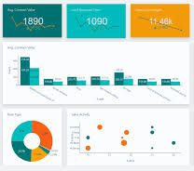
KPI Dashboard
Track performance across technical, operational, and business metrics to demonstrate security ROI.
Technical Metrics
Business Metrics
Mean time to triage
Mean time to contain
True positive rate
False positive rate
False negative rate
Click-rate reduction
Repeat-report rate
Account takeover incidents
Customer friction rate
Analyst hours saved
Compliance audit exceptions
Source: IBM, 2024; NIST, 2024

Slide 37






Business Case and ROI
Connect AI defense investments to measurable business value across risk reduction and operational efficiency.
Lower Breach Exposure
Faster Triage
Reduce probability and impact of successful phishing attacks
Accelerate threat detection and response times
Reduced Workload
Lower Fraud Losses
Free analysts for high-value investigations
Prevent financial and data theft
Better Trust
Stronger Compliance
Strengthen customer confidence
Meet regulatory requirements
Source: IBM, 2024; Verizon, 2025

Slide 38
Key Findings
What Works
What Fails
What Must Be Governed
Semantic AI detection
Behavioral signal fusion
Agentic triage
Phishing-resistant MFA
Continuous validation
LLM-only detection
Fully autonomous response
Prompt-only safety
Poor PHI handling
One-time deployment
Data access
Model decisions
Agent tools
Human approvals
Audit logs
Vendor accountability
Source: Synthesized from HHS, CISA, NIST, OWASP, IBM, Verizon, Microsoft, Google Cloud, and AWS

Slide 39
Recommendations
01
02
03
Deploy phishing-resistant MFA
Use generative AI for analysis
Implement bounded SOC triage
Across employee, admin, and vendor portals
Not final autonomous authority
With evidence gathering capabilities
04
05
06
Minimize PHI exposure
Maintain human approval
Red-team AI systems
In all model workflows
For high-impact actions
Continuously

